Slide 1
JDBC-CRUD
Operations
Name :-Vikas Chavan
Enrollment No:-EBENO322572159

Slide 2
Aim:
To Perform CRUD operations in IDE (Eclipse) by using MySQL database and java JDBC
CRUD:- C – create (insert the row ) , R – read (select operation ) , U – update operation , D – delete operation

Slide 3
Requirements:
JDK
Eclipse IDE
MySQL Community Server
MySQL JDBC DRIVER

Slide 4
Procedure :
Create a Database
Create a Table – Student
Load the driver in your java program by using Driver Class Name
The loaded class will throw Exception So Surround the Class.forName() with try-catch block.
Create a Connection Object and Statement Object in Try-with-Recourses Statement.
Write the query in the String like as in MySQL workbench.
Execute the query by using executeUpdate() method by passing the String.

Slide 5
Don’t forget to Print all the caught Exceptions i.e. SQL and Non-SQL Exceptions
To get the operation feedback Create an if-else condition and the condition will be the executionUpdate() method as an int value.
This is the same steps for INSERT,DELETE and UPDATE.
The Select query requires ResultSet object ,getString() and While loop to print required number of Columns

Slide 6
JDBC Connection MySQL to eclipse
To connect Java application with the MySQL database, we need to follow 5 following step
Load the driver class.
Create Connection using DriverManager.
Use connection to fire queries{ Statement for static queries and PreparedStatement for dynamic queries}
Process the result. ResultSet
Close the connection.

Slide 7
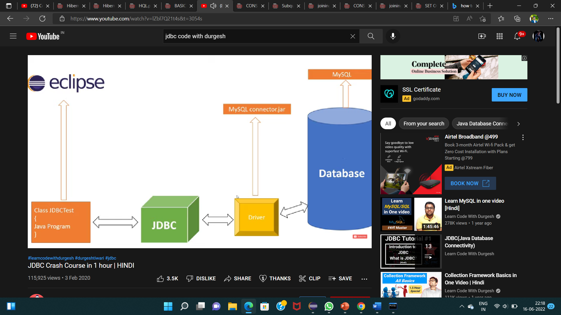
Intermediator

Slide 8
or
public static Connection createC()
{
try {
//load the driver
Class.forName("com.mysql.cj.jdbc.Driver");
//create the connection...
String user ="root";
String passworld = "Vikas123@";
String url="jdbc:mysql://localhost;3306/student_manage";
con=DriverManager.getConnection(url,user,passworld);
} catch (Exception e)
{ e.printStackTrace(); }
return con; }

Slide 9
CP
start
StudentDao
Student
CP
CP

Slide 10
Thank You

